Slide 1




$$E_{C}$$
$$E_{J}$$
$$L$$
$$C$$

Slide 2
T5
Oxford Fridge
OPX
Reso
Control
Reso
Output
Octave
Qubit
Control

Slide 3
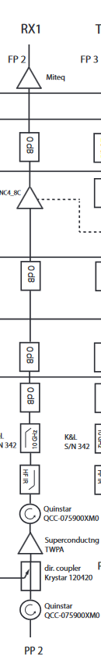
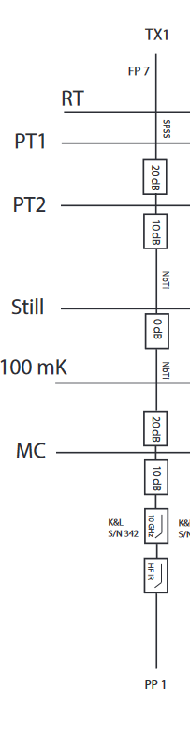
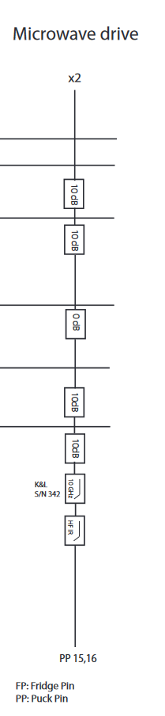
Room Temperature
10dB
20dB
0 dB
10dB
10dB
Cooling
0dB
0 dB
0 dB
Qubit Control
Readout Input
Readout Output
10dB
20dB
0 dB
10dB
10dB
0 dB
10 GHz
10 GHz
10 GHz
HF IR
HF IR
HF IR
TWPA

Slide 4
Room Temperature
PT1
10dB
20dB
0 dB
PT2
T5
Oxford Fridge
10dB
10dB
OPX
Still
Cooling
0dB
0 dB
0 dB
100 mK
Readout
Drive
Readout
Signal
10dB
20dB
0 dB
MC
Octave
10dB
10dB
0 dB
Qubit Control
Readout Input
Readout Output
10 GHz
10 GHz
10 GHz
Qubit
Control
HF IR
HF IR
HF IR
Soprano Chip
TWPA

Slide 5
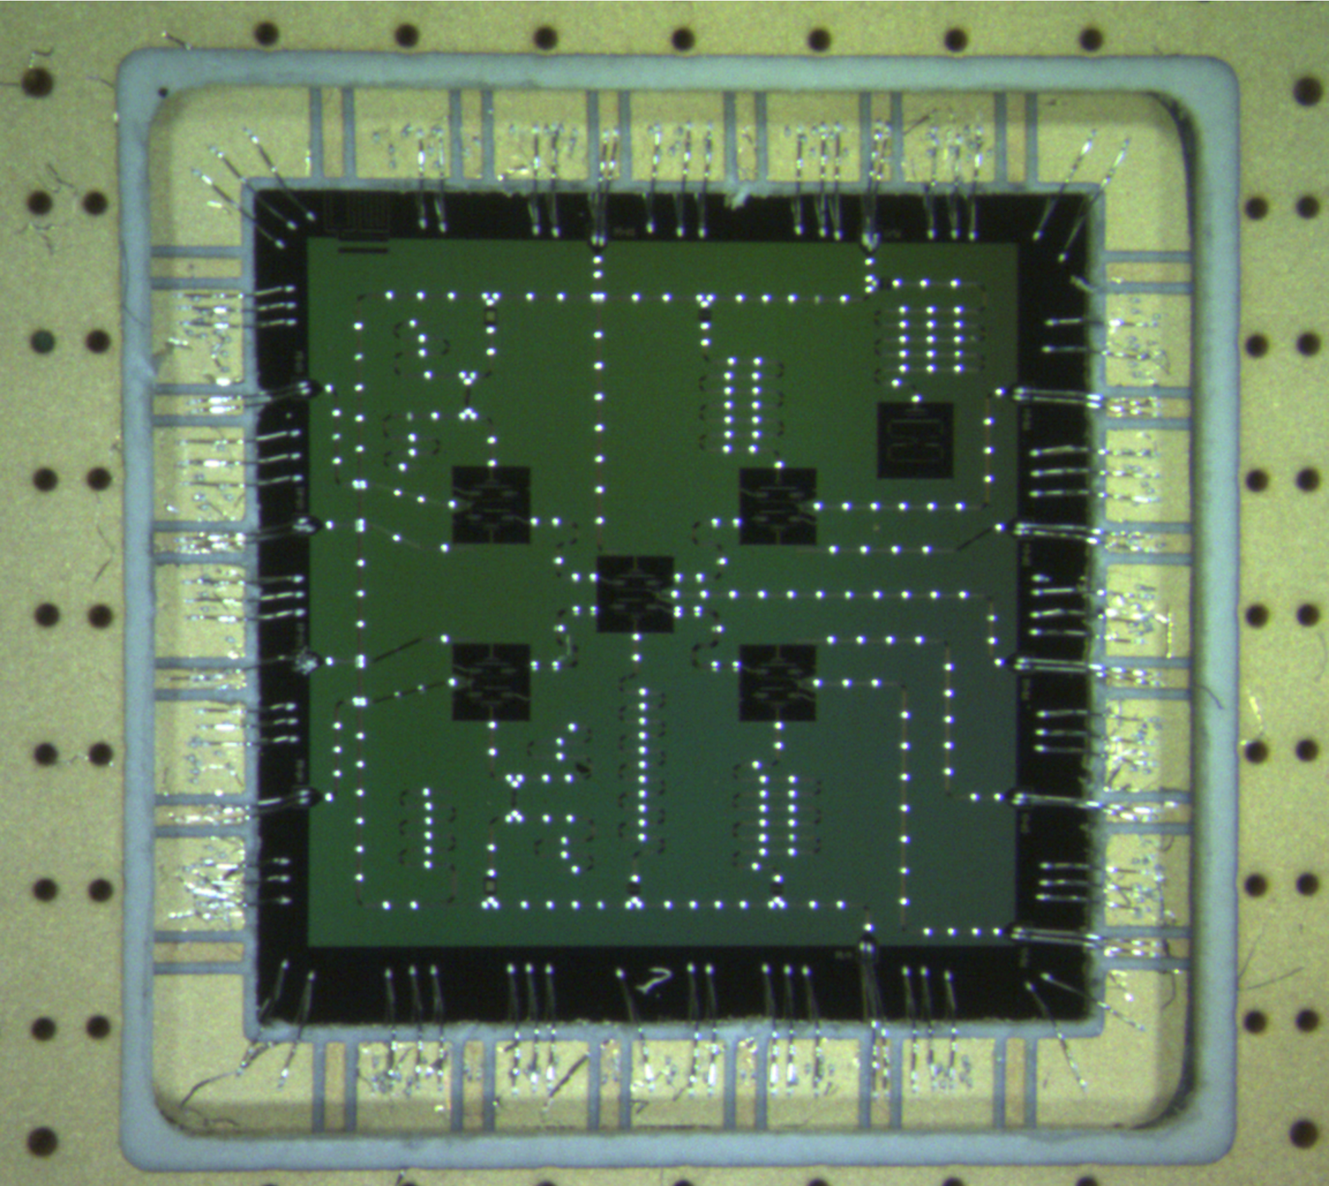
Readout Line
Flux line
Qubit
2
Control Line
Resonator

